Slide 1

Vikings Football
An exercise in mediocrity

Slide 2
A brief history
No Minnesotan born after 1991 has seen a MN mens sports team win a championship (Shoutout to the 2010s Lynx for being awesome)
The Wild, Twins, Timberwolves, and Vikings are consistently borderline playoff teams but never true contenders

Slide 3
Question
Is there an empiric way to show just how average the Vikings have truly been over the last twenty years?

Slide 4
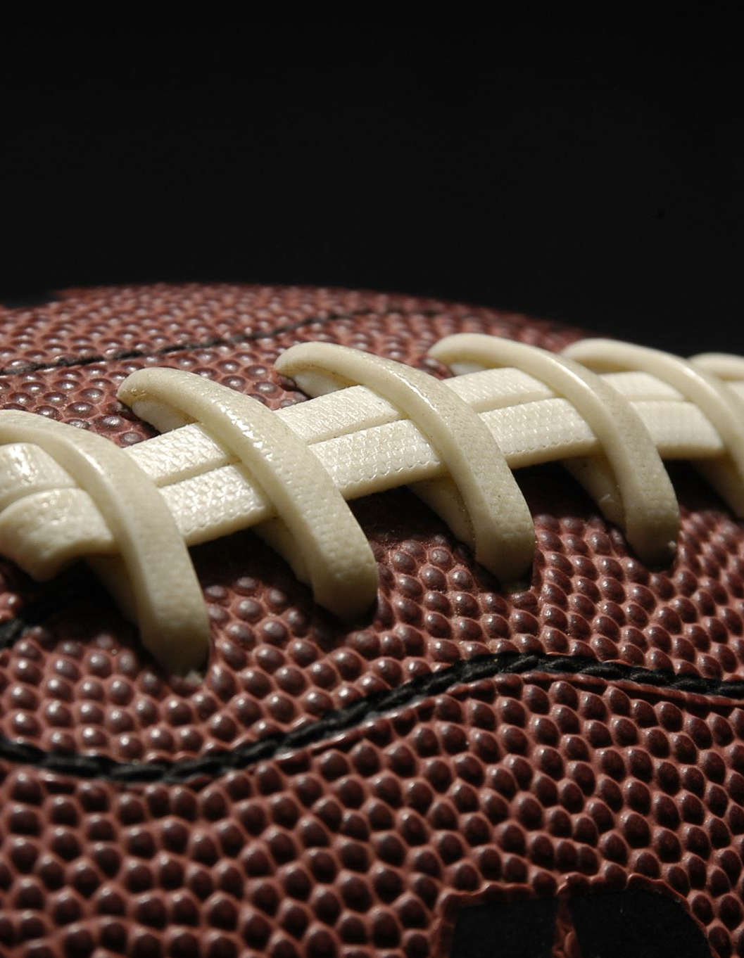
The Data
All data used for both my ML model as well as the visualizations were scraped from pro-football reference
The data had to be loaded into three distinct data frames and was then combined for the final dataset
Data cleaning was done to remove NA values as well as make the column headers more readable

Slide 5
Methodology
Create a ML model to determine which stats were most important to predicting fi someone would win the super bowl
Take those stats and show them season over season for the league average, the Vikings, and the super bowl winner that year

Slide 6
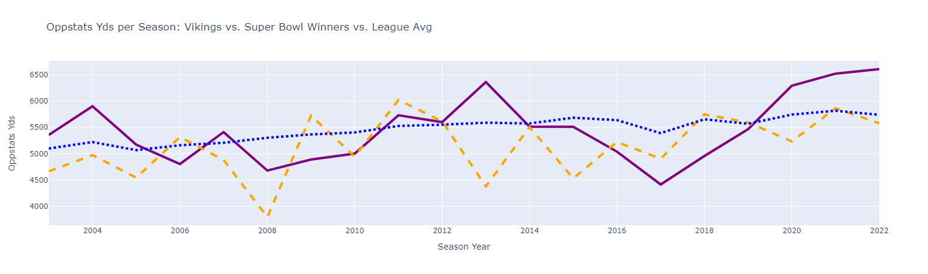
Results: Opponent’s Offensive Yards

Slide 7
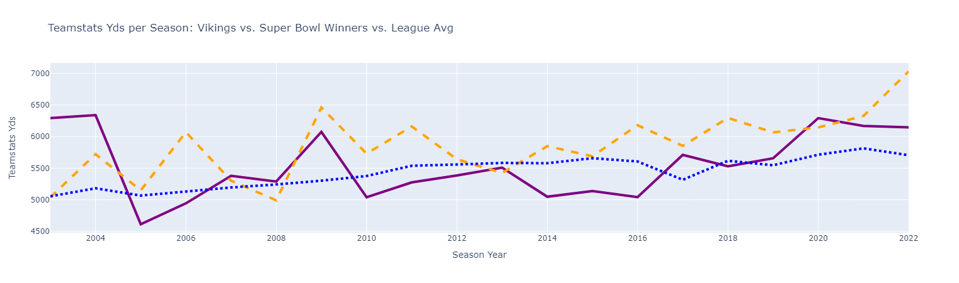
Results: Yards Per Season

Slide 8
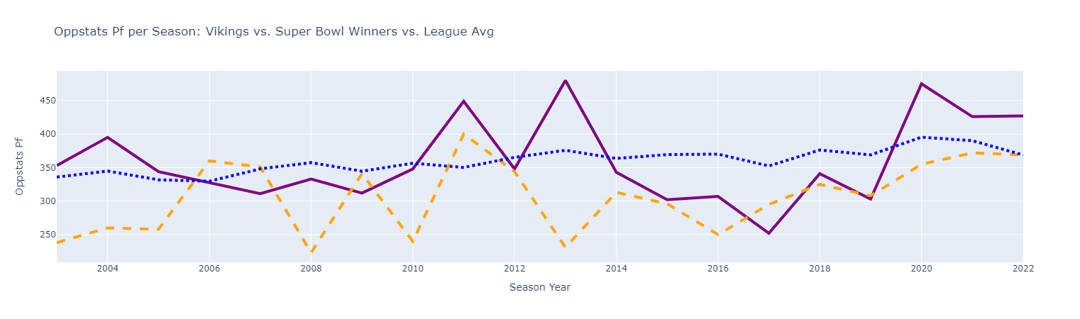
Results: Oppositions Points Scored

Slide 9
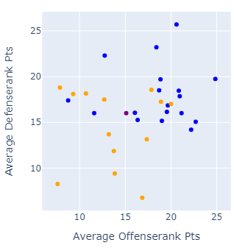
Results: Scatter Plot of Average Offensive and Defensive Rank (Last 20 Seasons)

Slide 10
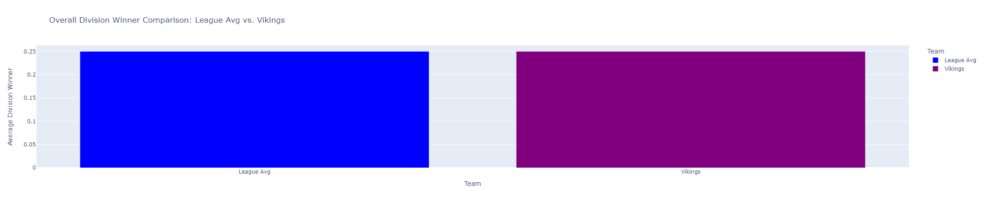
Results: Rate of Division Wins (Last 20 Seasons)

Slide 11
Conclusion
The Vikings are perhaps the most mediocre franchise in all of sports
Truly average in everything for a sustained amount of time
Minnesotans deserve better

